Slide 1
CS2106 Tutorial 1
T01/T02
Yifan

Slide 2
About me
Yifan
Year 3 Computer Science
email: zhang.yifan@u.nus.edu for any questions
tele: @yifandonlyif for urgent messages

Slide 3
Admin
Tutorials: 10%
5% attendance/participation
5% quiz (Opens on Wednesday, closes on Saturday)
Please use your real name for your zoom name!
Attendance is taken via Zoom meeting log
If I can’t recognise who you are, I can’t mark you as attended
Read and attempt the questions before the tutorial

Slide 4
Question 1

Slide 5
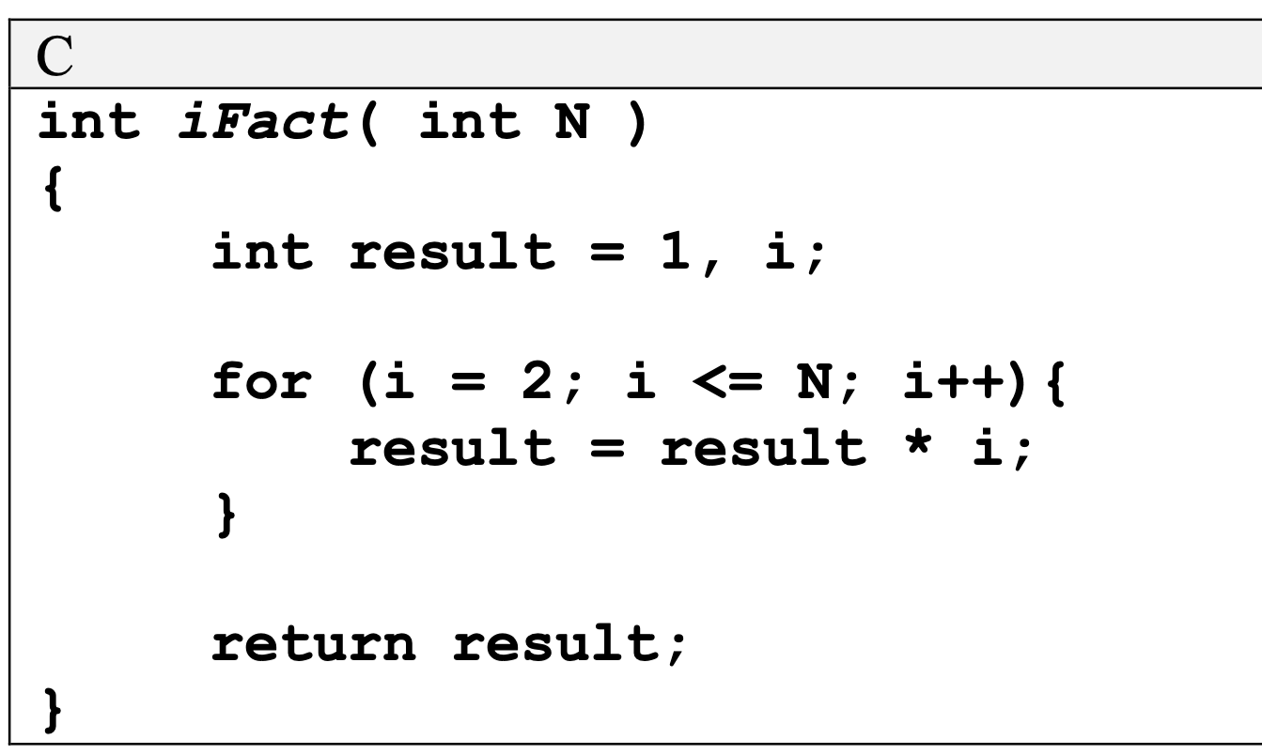
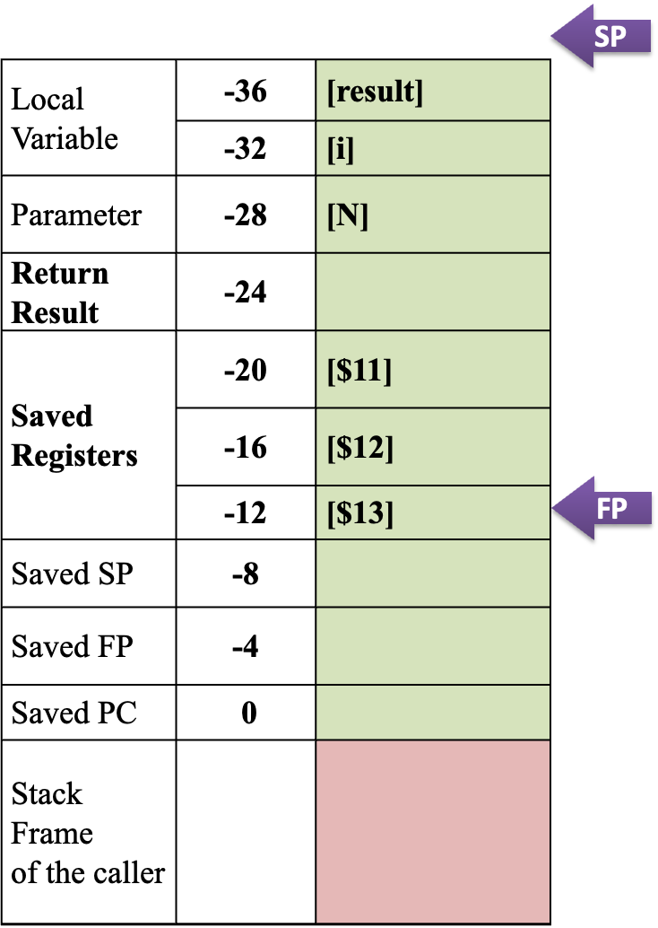
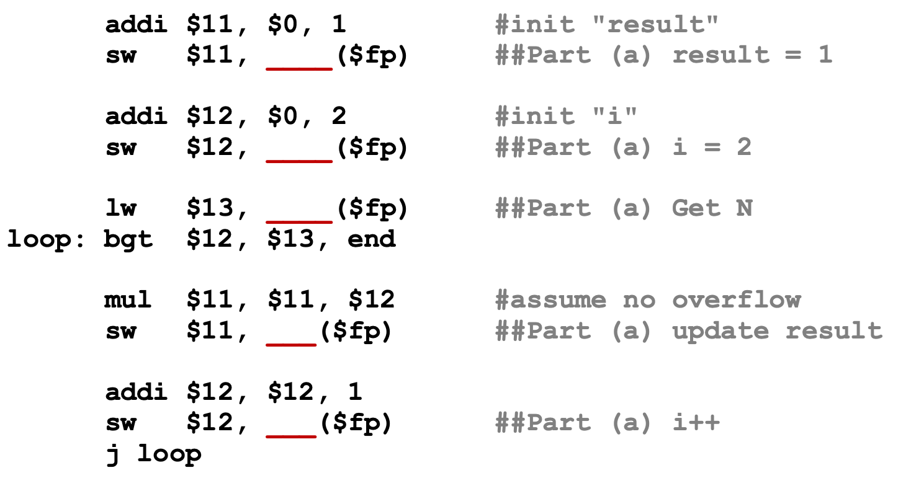
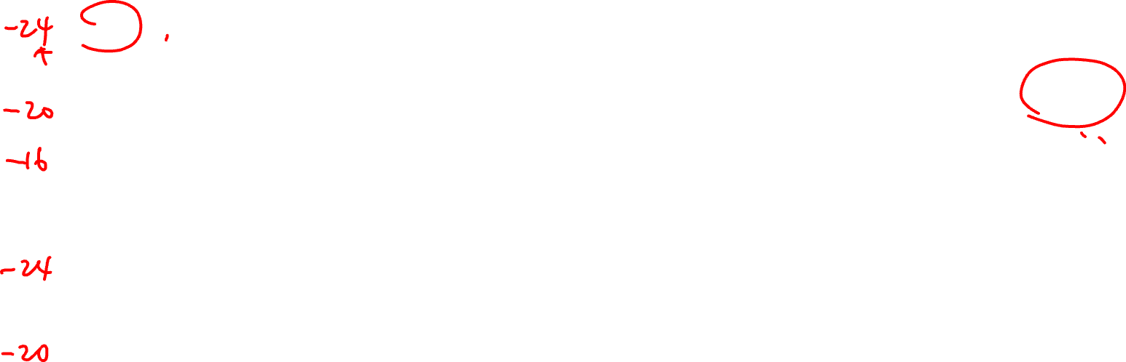
Question 1a

Slide 6
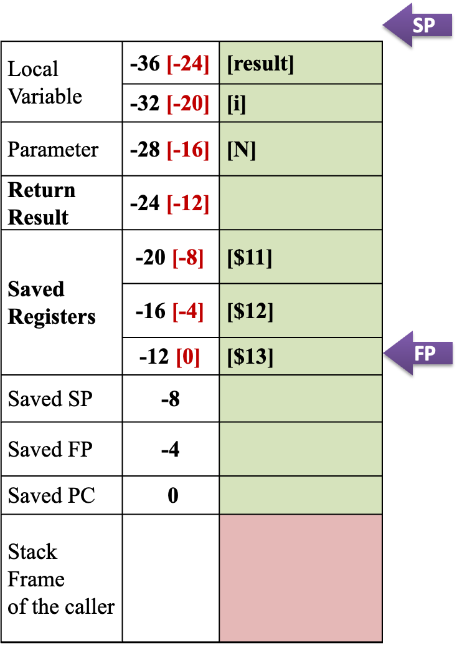
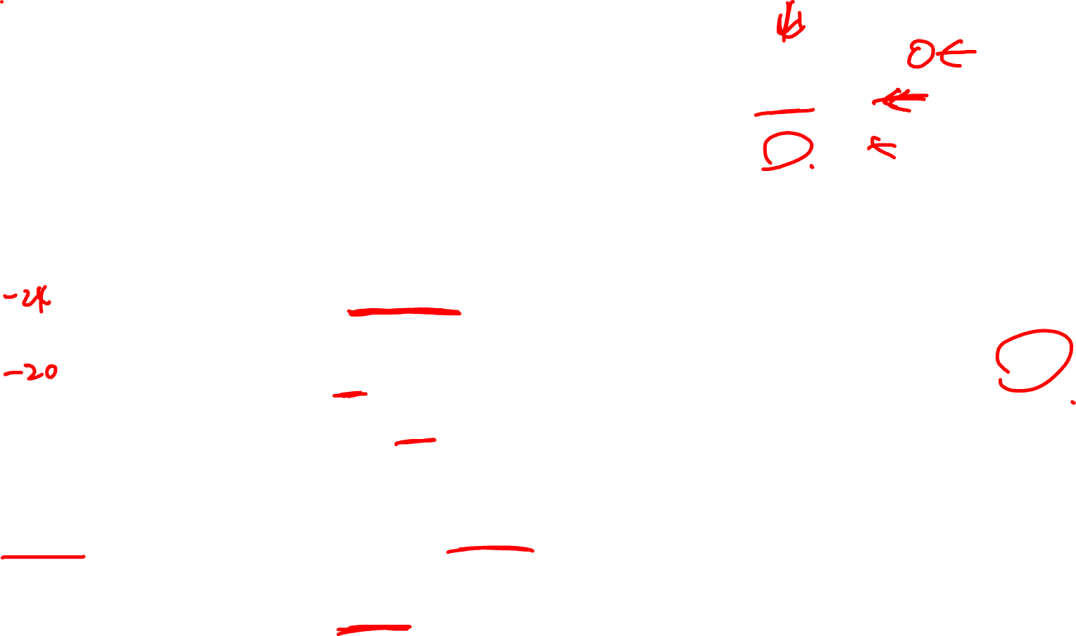
Question 1a

Slide 7
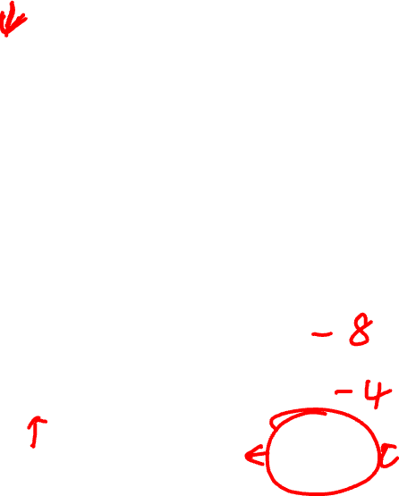
Question 1a

Slide 8
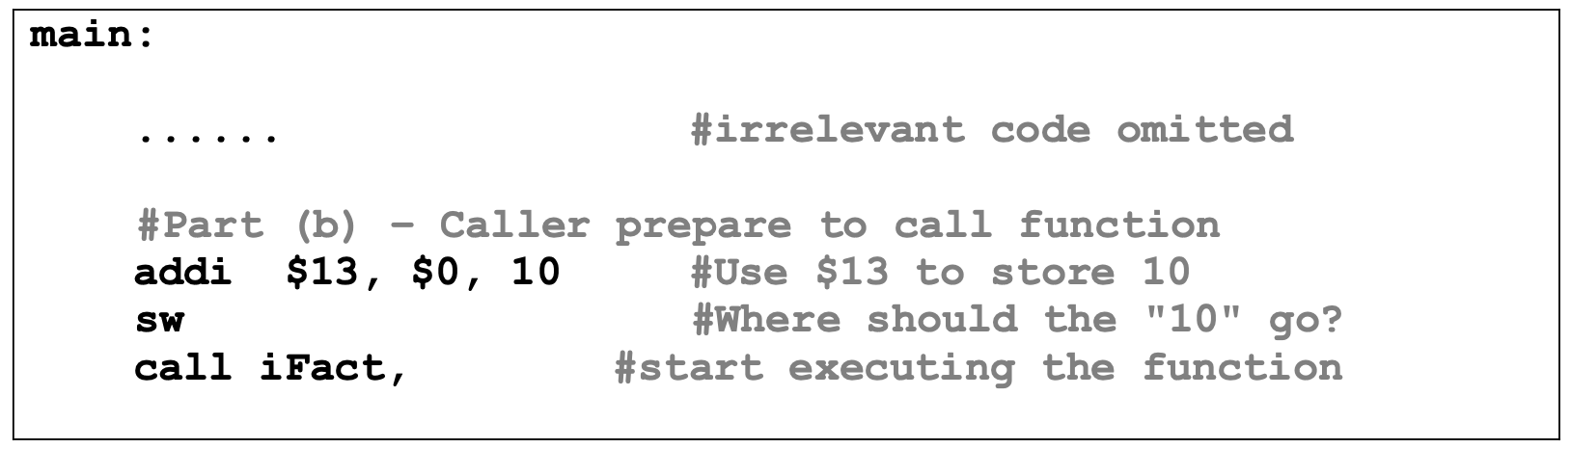

Question 1b

Slide 9
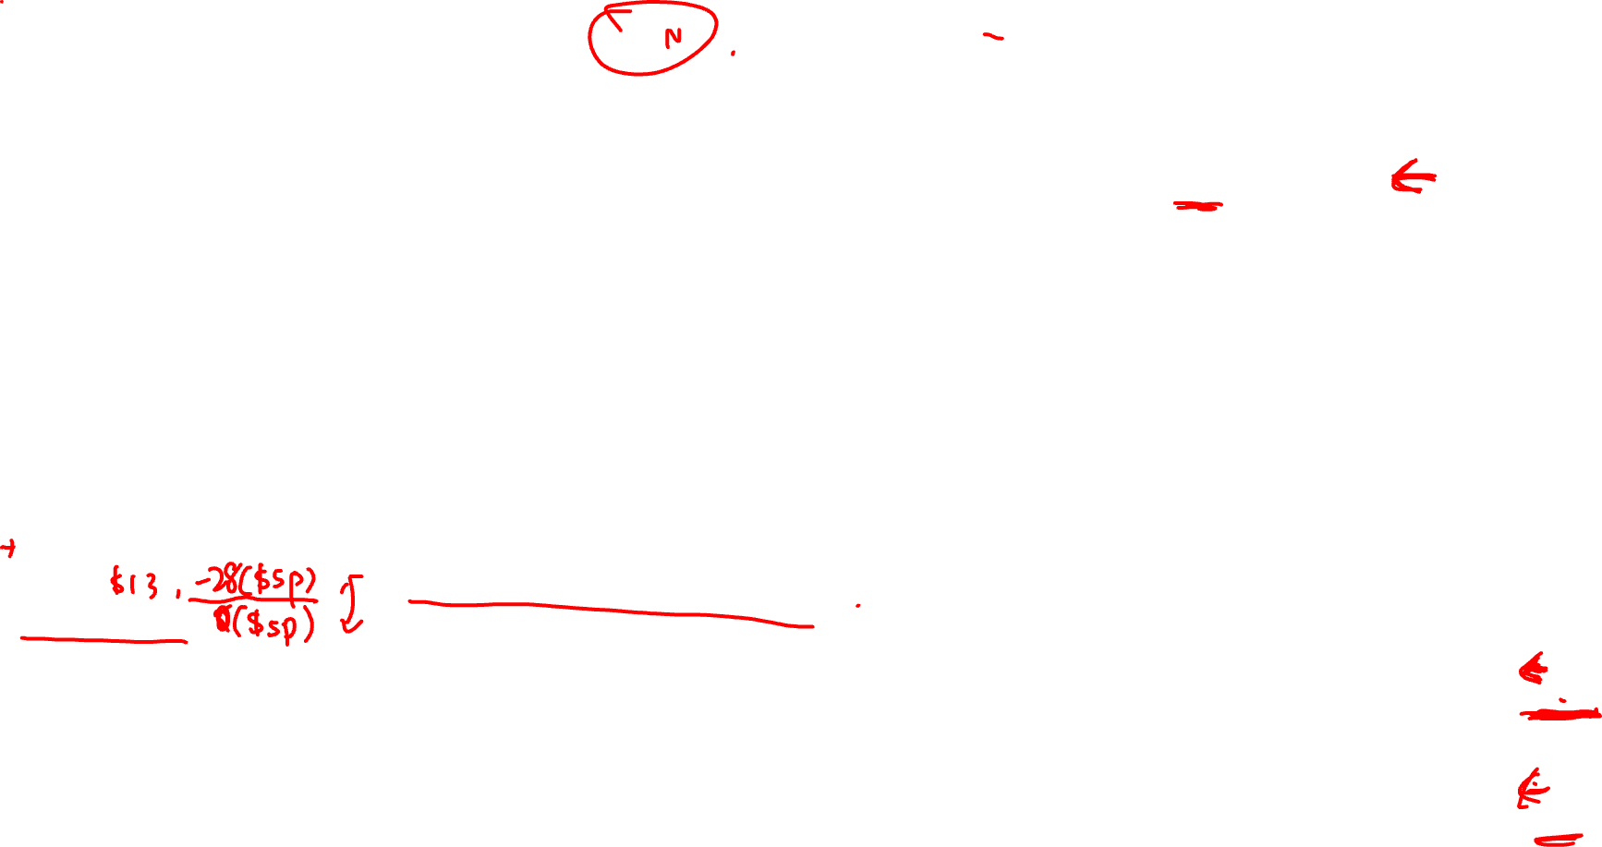
Question 1b

Slide 10
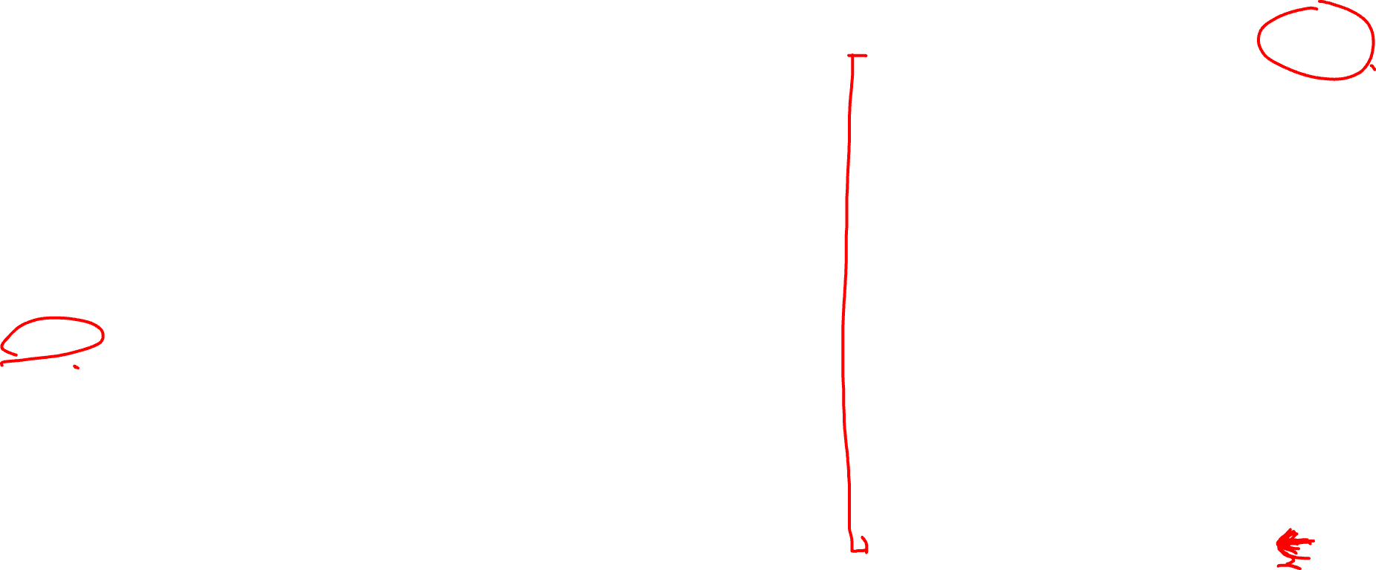
Question 1b

Slide 11
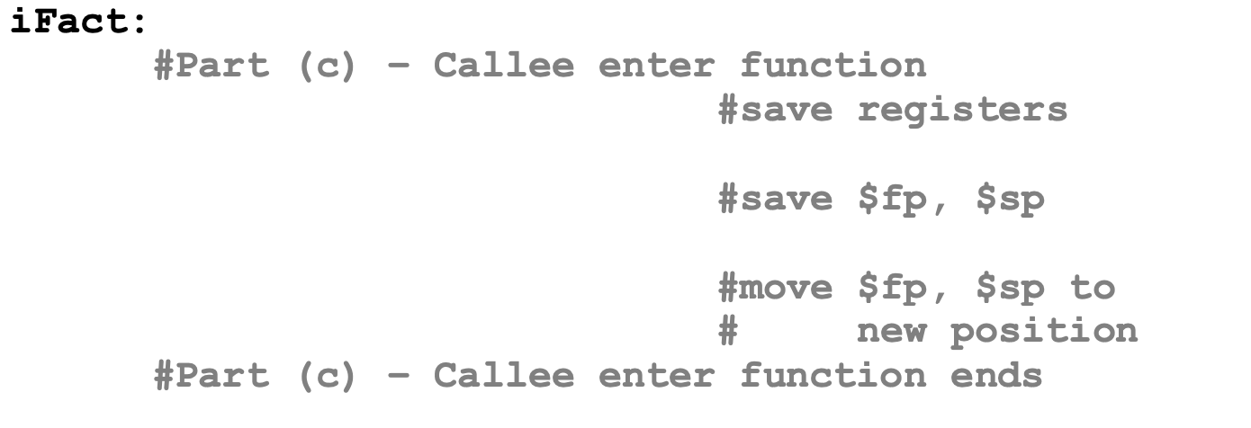
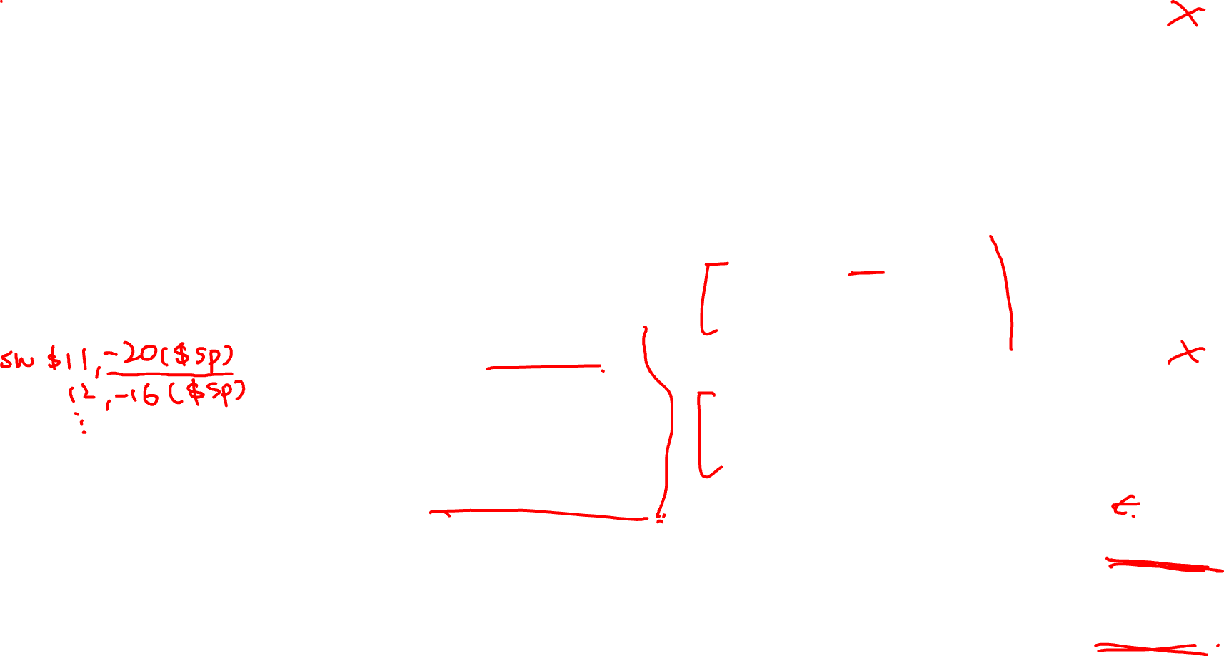
Question 1c

Slide 12
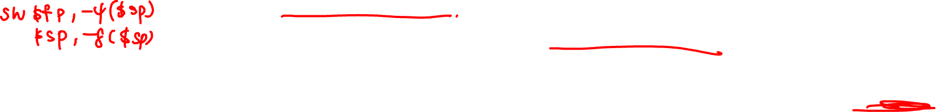
Question 1c

Slide 13
Question 1c

Slide 14

Question 1c

Slide 15
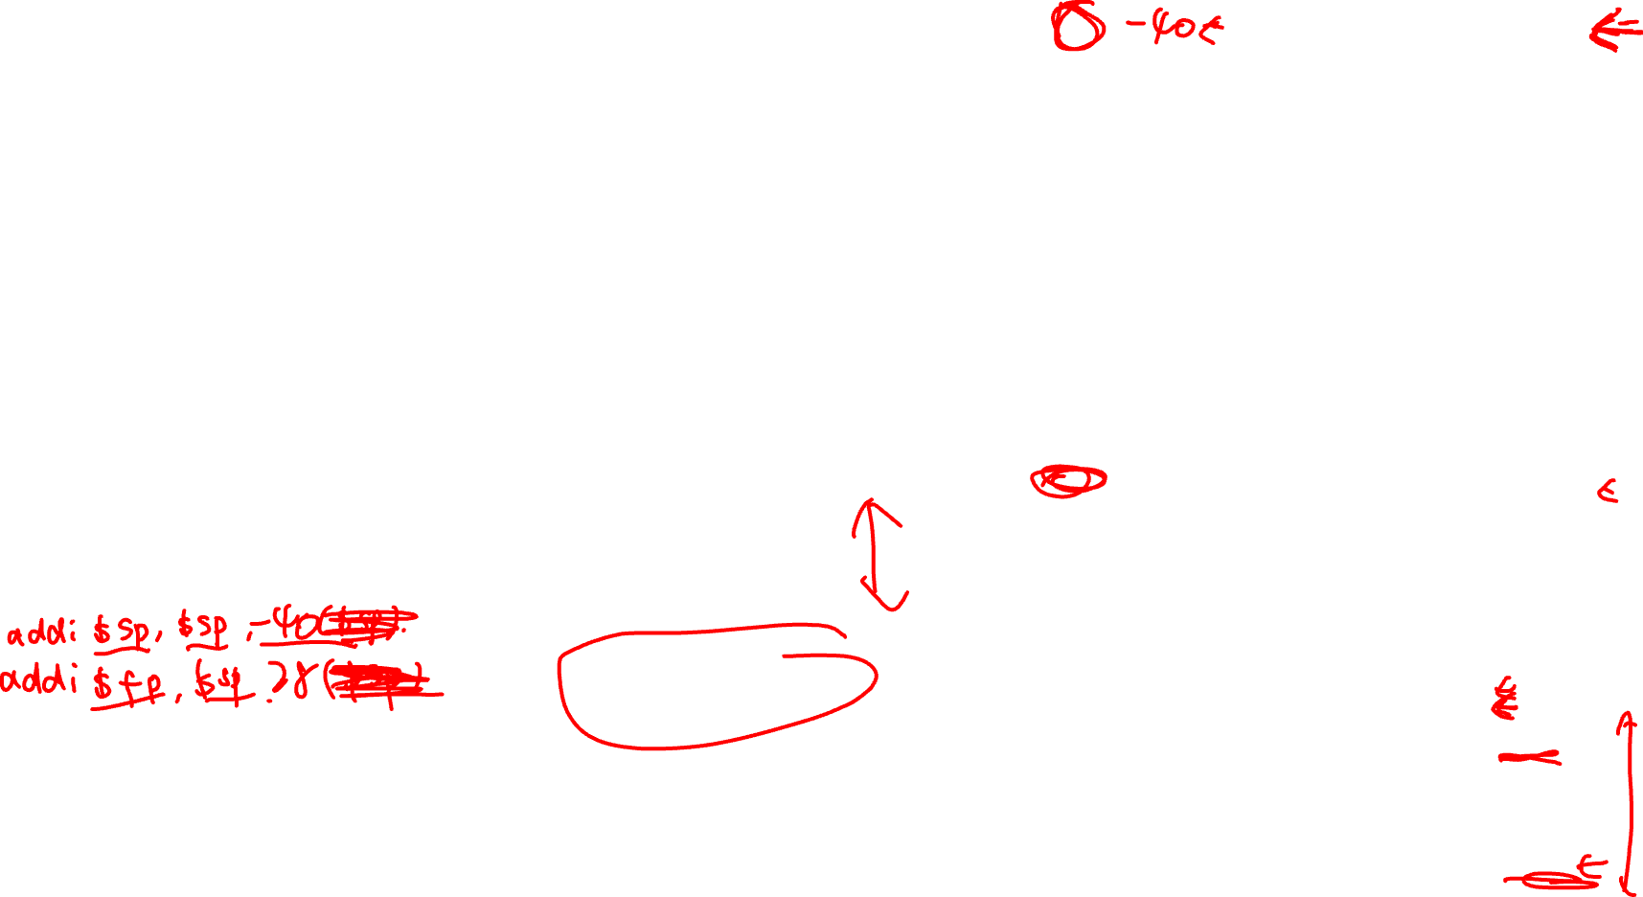
Question 1c

Slide 16
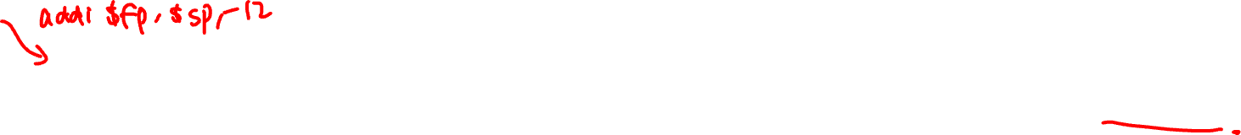
Question 1c

Slide 17
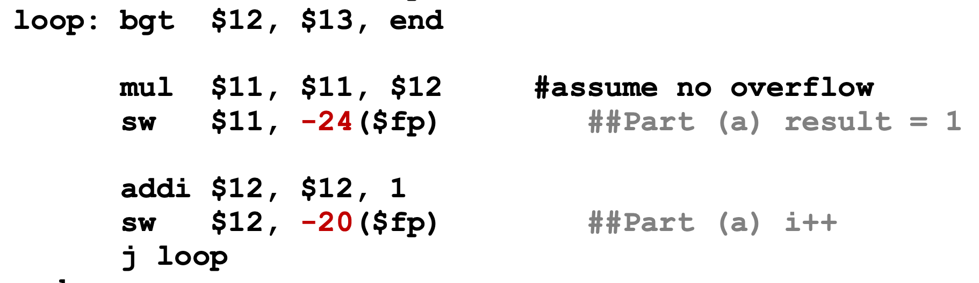
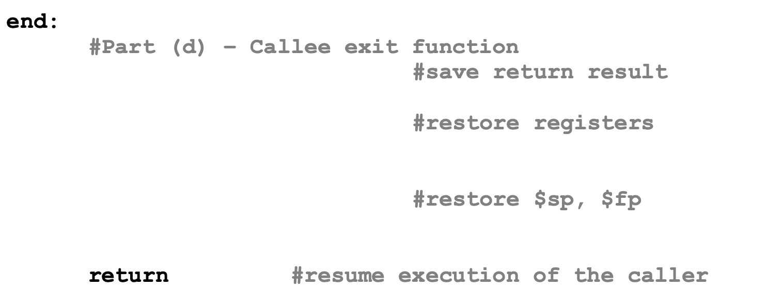
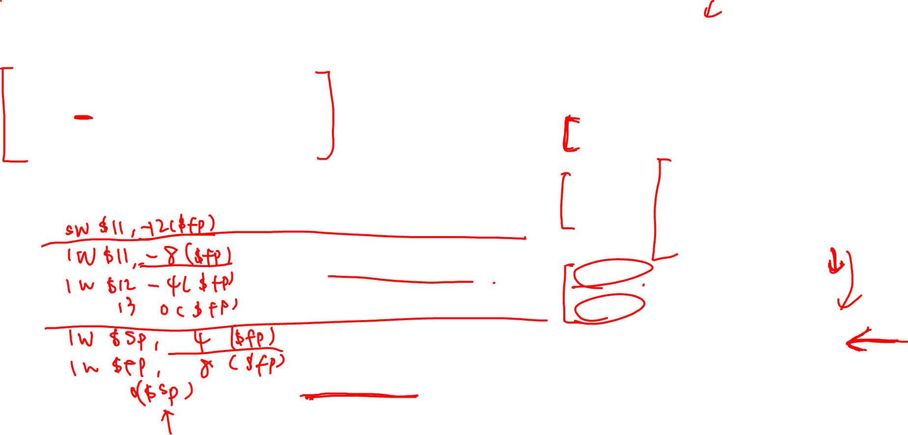
Question 1d

Slide 18

Question 1d

Slide 19
Question 1
Points to note
Convention:
when callee enters function, Set SP first, then set FP base on SP.
inside function call, FP is not moved and all variable access use FP as the reference, since SP may move (e.g. when another function call happens / dynamic allocation of variable on stack at the middle of call)

Slide 20
Question 2

Slide 21
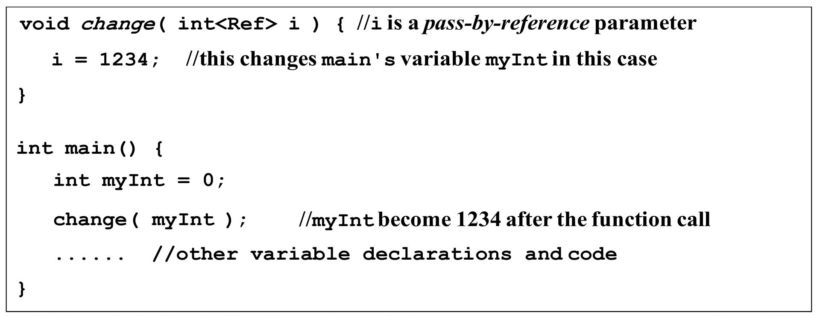
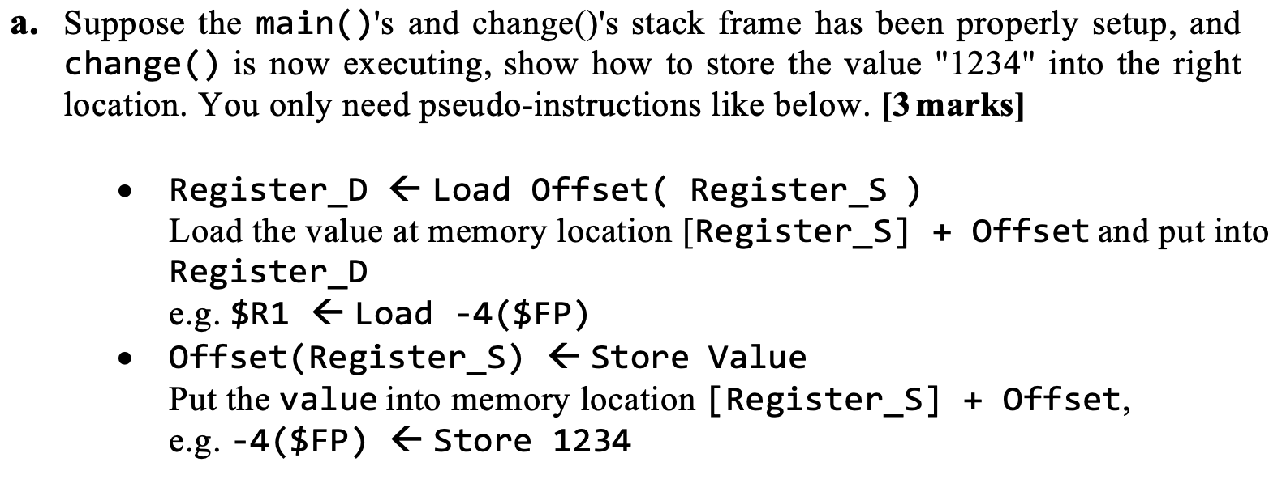
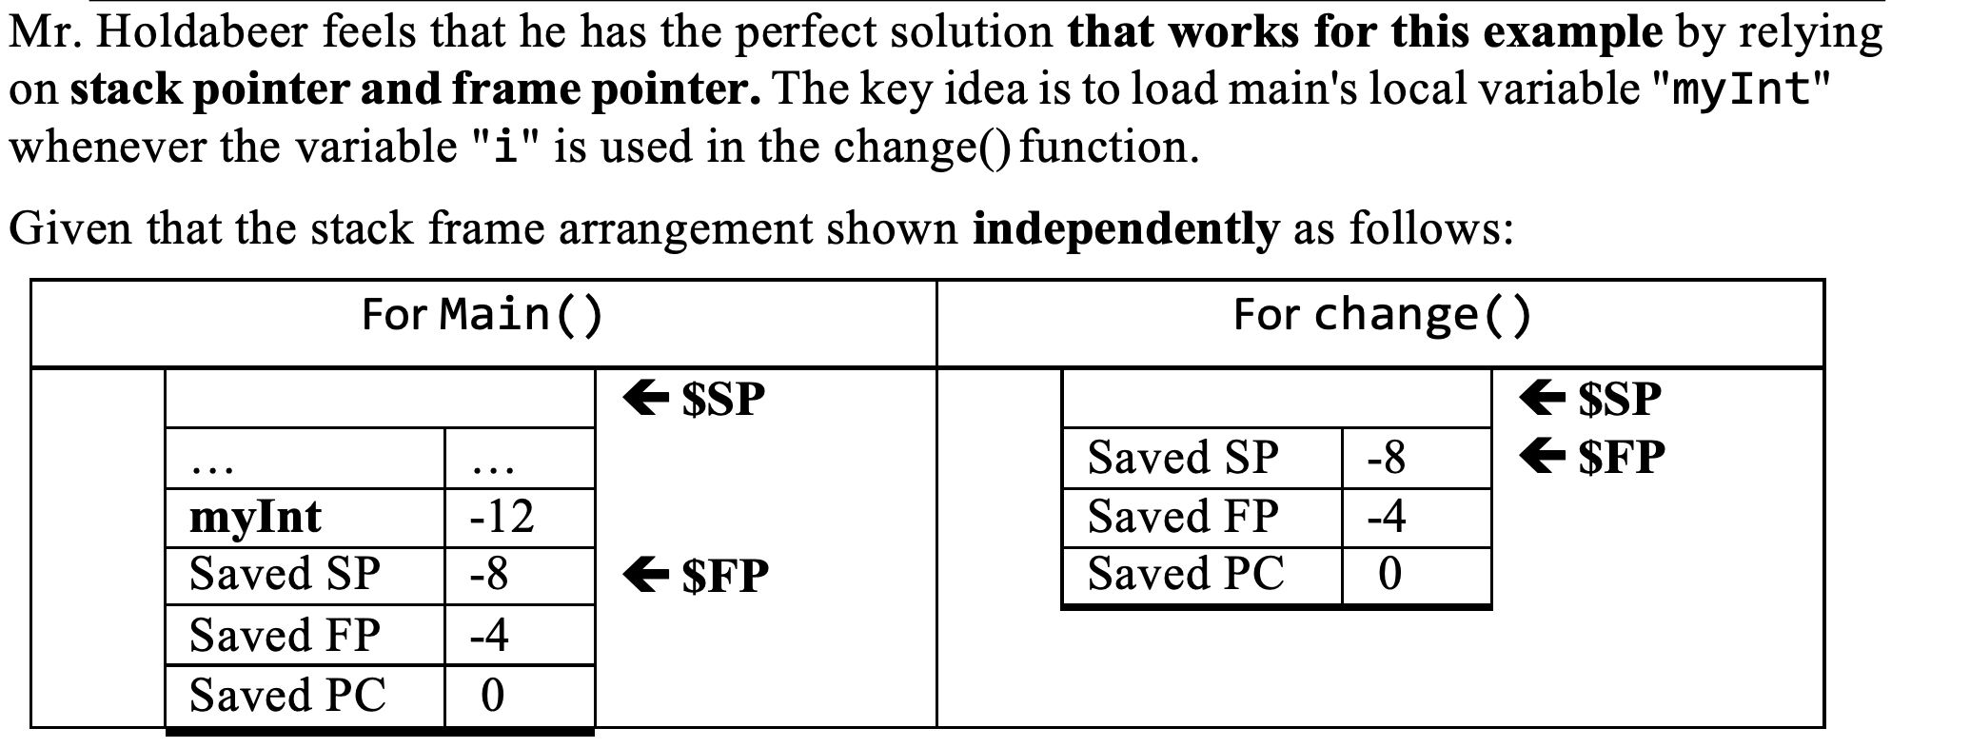
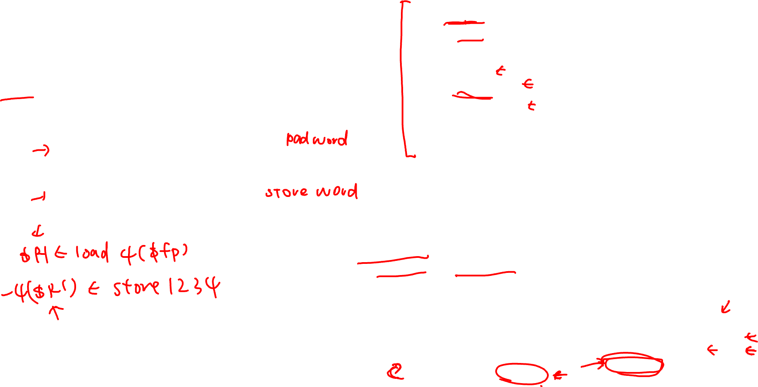
Question 2a

Slide 22
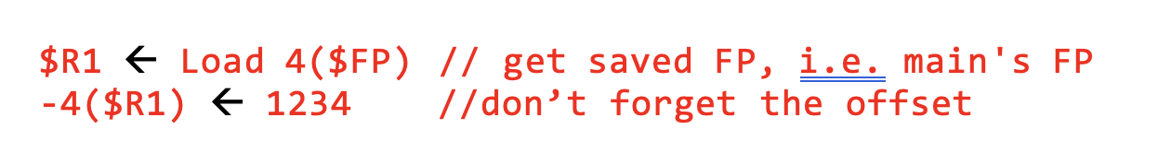
Question 2a

Slide 23
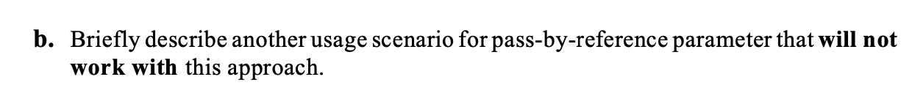
Question 2b

Slide 24
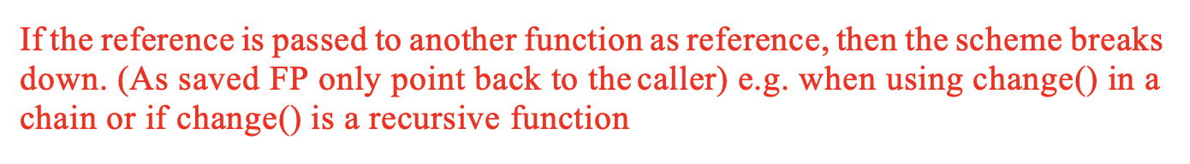

Question 2b

Slide 25
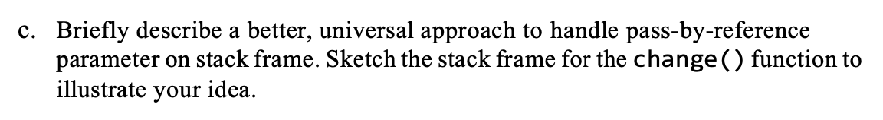
Question 2c

Slide 26
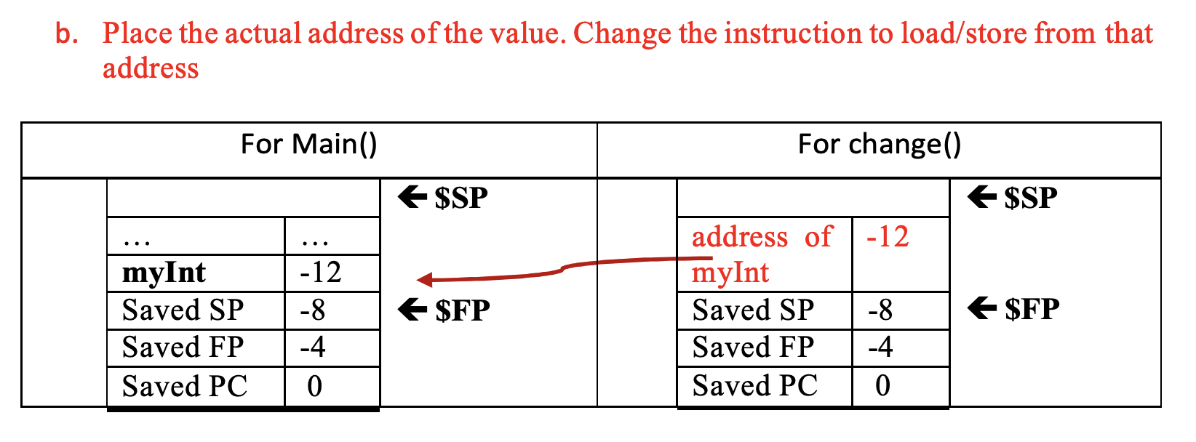
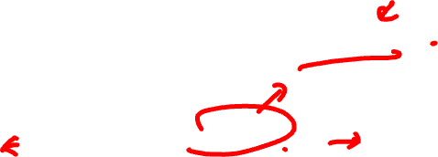
Question 2c

Slide 27
Question 3

Slide 28

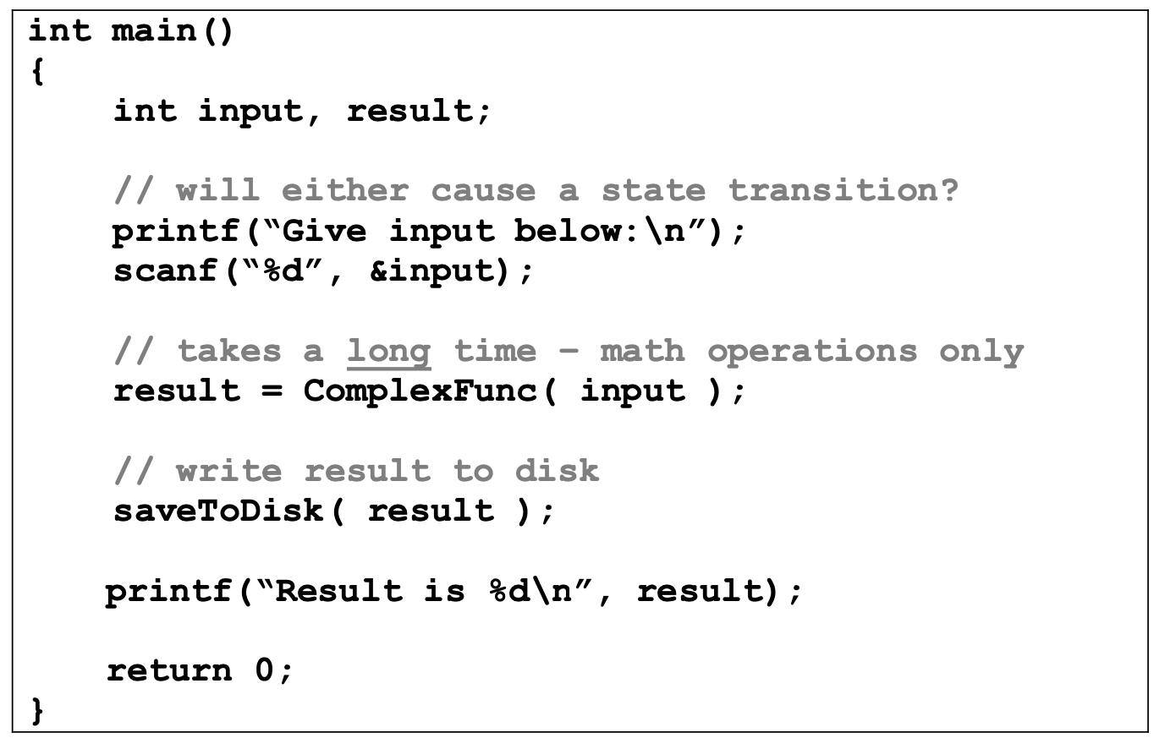
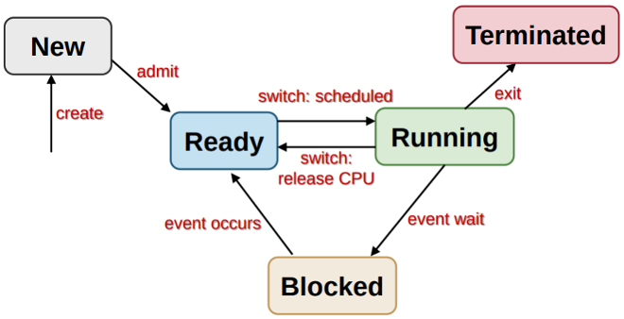

Question 3

Slide 29

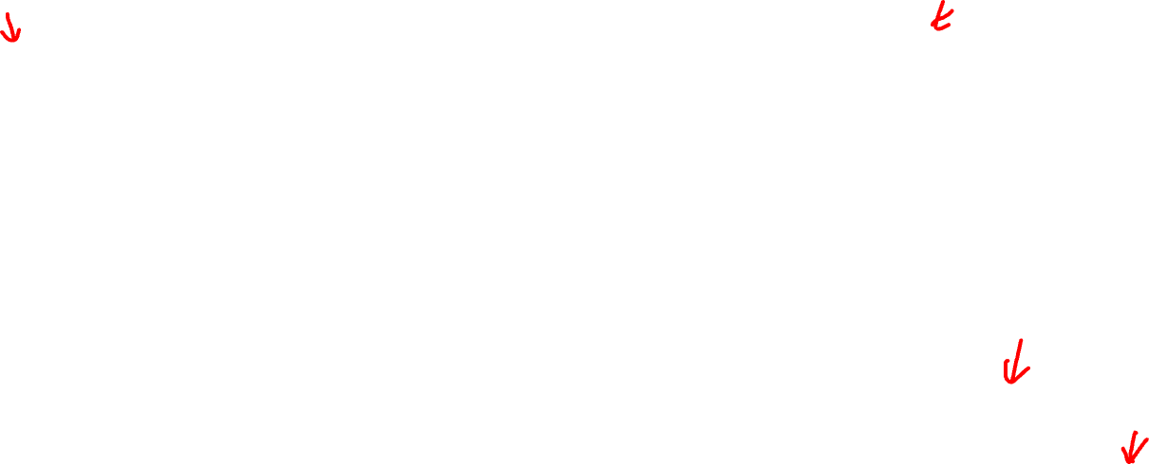
Question 3
OS creates a new process to execute main()
New process is placed in some queue where it waits to be scheduled

Slide 30

Question 3
OS schedules the new process to run

Slide 31
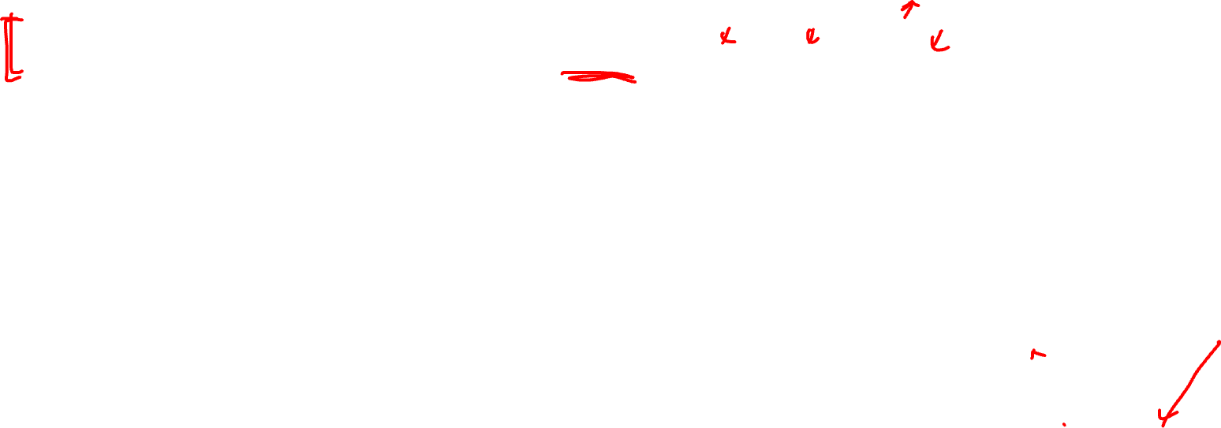
Question 3
I/O operations may cause blocking
Process gets unblocked as soon as I/O operation completes

Slide 32


Question 3
Process may be interrupted while running
Won’t be blocked but still need to wait to be rescheduled

Slide 33
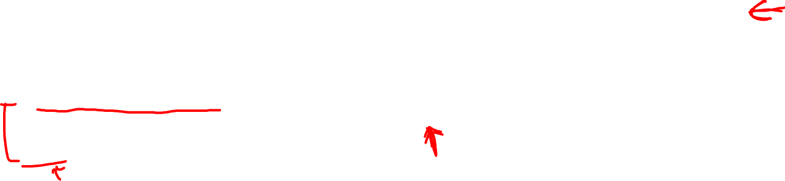
Question 3

Slide 34

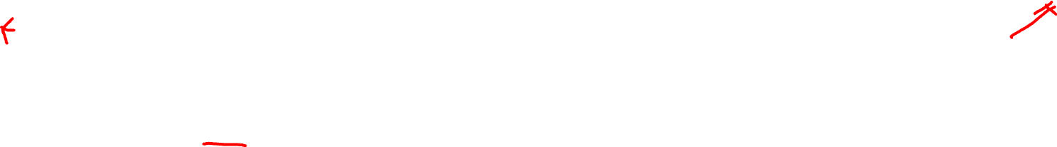
Question 3
Process call exit() to terminate execution
OS can release all the resources of the termination process

Slide 35
Thank you & see you next week!

Slide 36
Q&A
When is stack expanded?
When stack dynamic variables are declared inside the function
1b) and 1d), call/return register
For 1b, you haven’t moved the new FP/SP and saved reg for iFact yet, and the allocation start at 0($sp) as the reference, so things are starting at 0($sp);
For 1d, you are returning to the top of the previous call’s stack because if anything was to be added, it will be added from there.
Also, in MIPS jal and jr are used for actual function calls and returns

